Slide 1




T.C.
İSTANBUL GELİŞİM UNİVERSİTY
https://gelisim.edu.tr https://shmyo.gelisim.edu.tr

Slide 2

Name of Department | :
Course Code and Name | :
Course Week | :
Course Day and Time | :
Course Credit/ACTS Information | :
Examination Type and Gradings | :
Instructor’s Name & Surname | :
E-mail & Phone: | :
Instructor’s Room | :
Office Hours | :
GBS Link | :
ALMS Link | :
AVESIS Link | :
https://shmyo.gelisim.edu.tr
https://gelisim.edu.tr

Slide 3
| 14 WEEKS’S COURSE CONTENTS |
https://shmyo.gelisim.edu.tr
https://gelisim.edu.tr

Slide 4
| WEEKLY LEARNING OUTCOMES |
https://shmyo.gelisim.edu.tr
https://gelisim.edu.tr

Slide 5
| ABOUT THE PREVIOUS COURSE |
https://shmyo.gelisim.edu.tr
https://gelisim.edu.tr

Slide 6

| DAILY FLOW |
09.00-09.50/ 1st Hour
10.00-10.50/ 2nd Hour
11.00-11.50/ 3rd Hour
12.00-12.50/ 4th Hour
https://shmyo.gelisim.edu.tr
https://gelisim.edu.tr

Slide 7
| ADD HEADER |
NOTE: In this section, the instructor is free to decide on the depth/breadth of the course and teaching methods and techniques.
It is up to the instructor to decide how many slides will be used
For example; The course can be taught with audio-visual elements, the course can also be taught through a book/article by specifying the source-access information in this section.
https://shmyo.gelisim.edu.tr
https://gelisim.edu.tr

Slide 8
NOTE: In this section, the instructor is free to decide on the depth/breadth of the course and teaching methods and techniques.
It is up to the instructor to decide how many slides will be used
For example; The course can be taught with audio-visual elements, the course can also be taught through a book/article by specifying the source-access information in this section.
https://shmyo.gelisim.edu.tr
https://gelisim.edu.tr

Slide 9
NOTE: In this section, the instructor is free to decide on the depth/breadth of the course and teaching methods and techniques.
It is up to the instructor to decide how many slides will be used
For example; The course can be taught with audio-visual elements, the course can also be taught through a book/article by specifying the source-access information in this section.
https://shmyo.gelisim.edu.tr
https://gelisim.edu.tr

Slide 10
Fixed Logo
If you proceed by duplicating this slide, the size of the logo will remain constant
https://shmyo.gelisim.edu.tr
https://gelisim.edu.tr

Slide 11
Adjustable Logos
Every logo in this page is adjustable.
If you want to go on with adjustable logos, proceed to duplicate this page
https://shmyo.gelisim.edu.tr
https://gelisim.edu.tr

Slide 12
| WHAT TO TAKE HOME? |
https://shmyo.gelisim.edu.tr
https://gelisim.edu.tr

Slide 13
| QUESTIONS AND SUGGESTIONS|
https://shmyo.gelisim.edu.tr
https://gelisim.edu.tr

Slide 14
| RECOMMENDED WEEKLY STUDIES|
https://shmyo.gelisim.edu.tr
https://gelisim.edu.tr

Slide 15
| ABOUT THE NEXT WEEK |
https://shmyo.gelisim.edu.tr
https://gelisim.edu.tr

Slide 16
| REFERENCES |
https://shmyo.gelisim.edu.tr
https://gelisim.edu.tr

Slide 17
………….. – …………………………
Since course presentations are private, using the texts and images contained herein on social media or else without permission from the course instructor is against the regulations Law No. 6698.
https://shmyo.gelisim.edu.tr
https://gelisim.edu.tr

Slide 18
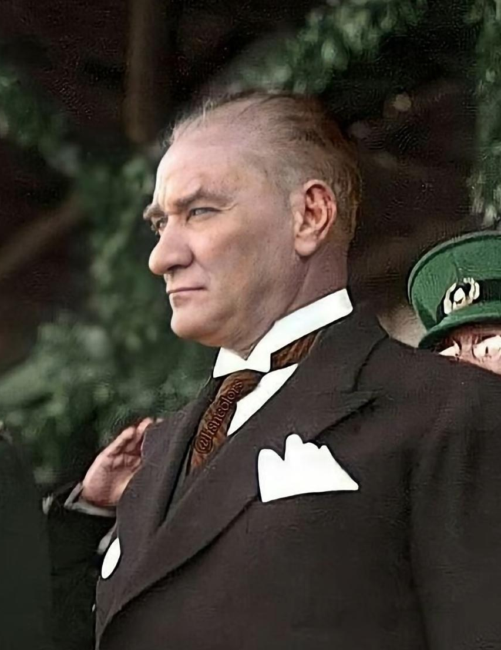
Not: Quotes from ATATÜRK can be added weekly
https://shmyo.gelisim.edu.tr
https://gelisim.edu.tr

Slide 19
THANK FOR YOUR ATTENDANCE…
https://shmyo.gelisim.edu.tr
https://gelisim.edu.tr

