Slide 2
Name of Department | :
Course Code and Name | :
Course Week | :
Course Day and Time | :
Course Credit/ACTS Informations | :
Examination Type and Gradings | :
Instructor’s Name & Surname | :
E-mail & Phone: | :
Instructor’s Room | :
Office Hours | :
GBS Link | :
ALMS Link | :
AVESIS Link | :

Slide 3
14 WEEKS’S COURSE CONTENTS

Slide 4
WEEKLY LEARNING OUTCOMES
Slaytlarında web sitesi adresleri yok.
Web sitesi bilgisi yerine sosyal medya logoları var ama 7-12 numaralı slatylara sosyal medya logosu eklenmemiş!

Slide 5
ABOUT THE PREVIOUS COURSE

Slide 6
DAILY FLOW
09.00-09.50/ 1st Hour
10.00-10.50/ 2nd Hour
11.00-11.50/ 3rd Hour
12.00-12.50/ 4th Hour

Slide 7
ADD HEADER
NOTE: In this section, the instructor is free to decide on the depth/breadth of the course and teaching methods and techniques.
It is up to the instructor to decide how many slides will be used
For example; The course can be taught with audio-visual elements, the course can also be taught through a book/article by specifying the source-access information in this section.

Slide 8
NOTE: In this section, the instructor is free to decide on the depth/breadth of the course and teaching methods and techniques.
It is up to the instructor to decide how many slides will be used
For example; The course can be taught with audio-visual elements, the course can also be taught through a book/article by specifying the source-access information in this section.

Slide 9
NOTE: In this section, the instructor is free to decide on the depth/breadth of the course and teaching methods and techniques.
It is up to the instructor to decide how many slides will be used
For example; The course can be taught with audio-visual elements, the course can also be taught through a book/article by specifying the source-access information in this section.

Slide 10
Fixed Logo
If you proceed by duplicating these slides, the size of the logo will remain constant.

Slide 11
Adjustable Logos
Every logo in this page is adjustable.
If you want to go on with adjustable logos, proceed to duplicate this page

Slide 12
WHAT TO TAKE HOME?

Slide 13
QUESTIONS AND SUGGESTIONS

Slide 14
RECOMMENDED WEEKLY STUDIES

Slide 15
REFERENCES

Slide 16
ABOUT THE NEXT WEEK

Slide 17
………….. – ………………………… Since course presentations are private, using the texts and images contained herein on social media or else without permission from the course instructor is against the regulations Law No. 6698.

Slide 18
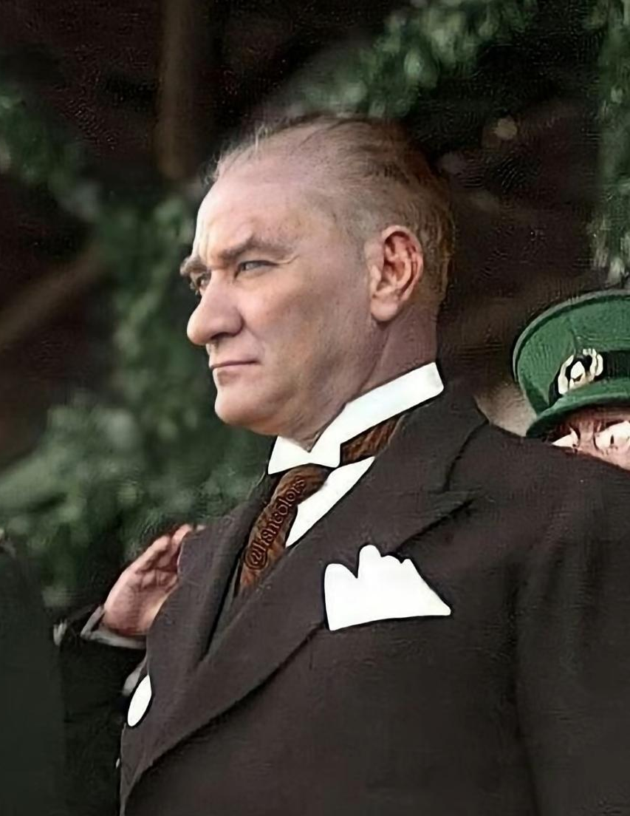
Not: Sayings from ATATÜRK can be added weekly

