Slide 1


www.gelisim.edu.tr

Slide 2

Department :
Course Code and Title :
Course Week : Course Day and Time : Course Credits / ECTS Information : Exam Type / Grading Distribution :
Course Instructor :
E-mail and Phone : Instructor’s Office :
Advisor Information : GBS Link :
ALMS Link :
AVESİS Link :

Slide 3
14-WEEK COURSE TOPICS

Slide 4
WEEKLY LEARNING OUTCOMES

Slide 5
OVERVIEW OF THE PREVIOUS COURSE

Slide 6

DAILY SCHEDULE
09.00-09.50/ FIRST COURSE
10.00-10.50/ SECOND COURSE
11.00-11.50/ THIRD COURSE
12.00-12.50/ FOURTH COURSE

Slide 7
BAŞLIK EKLEYİNİZ
NOTE: In this section, the instructor has flexibility regarding the depth and breadth of the course, as well as the teaching methods and techniques to be used. The instructor may decide how many slides will be used during the course. For example, the lesson may be conducted using audiovisual materials; alternatively, it may be based on a specific book or article, provided that the source and access information are indicated in this section.

Slide 8
NOTE: In this section, the instructor has full discretion regarding the depth and breadth of the course content, as well as the teaching methods and techniques to be used. The instructor is also free to decide the number of slides to be used during the lesson.
For instance; the course may be conducted using audiovisual materials, or it may be delivered based on a specific book or article, provided that the source and access information are indicated in this section.

Slide 9
NOTE: In this section, the instructor has full discretion regarding the depth and breadth of the course content, as well as the teaching methods and techniques to be used.
The instructor is free to decide how many slides will be used during the lesson. For example, the course may be conducted using audiovisual materials, or it may be delivered based on a specific book or article, provided that the source and access information are indicated in this section.

Slide 10
Fixed Logo
If you proceed by right-clicking >> on these slides and selecting Duplicate Slide, you will be able to use slides where the size and position of all logos remain fixed.

Slide 11
Animated Logo
If you duplicate this slide by right-clicking >> Duplicate Slide, you will be able to work with slides where you can move and resize the logos.

Slide 12
WHAT DID WE LEARN TODAY?

Slide 13
QUESTIONS AND SUGGESTIONS

Slide 14
SUGGESTED WEEKLY ASSIGNMENTS

Slide 15
REFERENCES

Slide 16
ABOUT THE NEXT COURSE

Slide 17
Since the presentations related to Course …………… ........... are confidential, the use of the texts and visuals contained herein on social media or other platforms without permission from the course instructor violates the regulations protecting personal data and privacy as guaranteed by Law No. 6698.

Slide 18
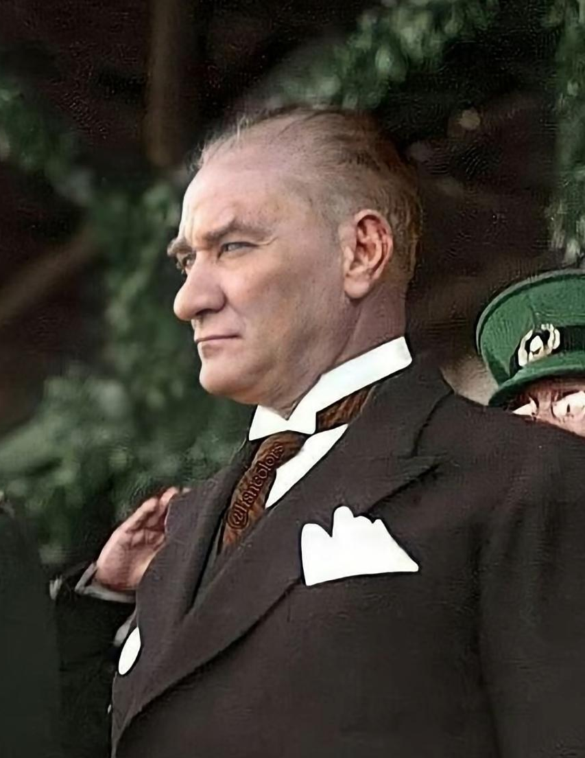
NOTE: A different quote from Mustafa Kemal Atatürk can be added for each week.

Slide 19
THANK YOU FOR YOUR PARTICIPATION…..
www.gelisim.edu.tr

