Slide 1
IN-TERM PROFESSIONAL INTERNSHIP STUDENT INTERNSHIP APPLICATION GUIDE
BİLGİ İŞLEM DAİRE BAŞKANLIĞI

Slide 2
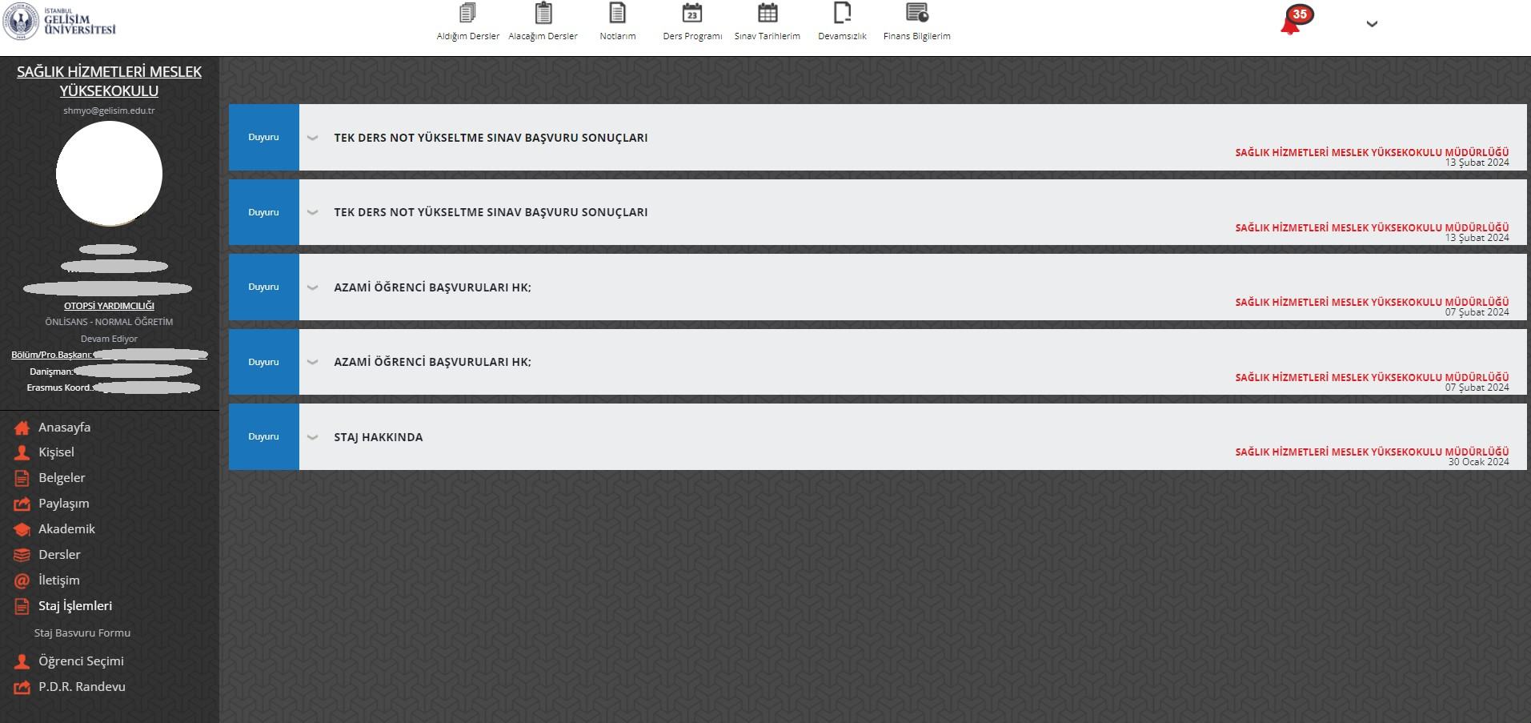
ONLİNE STAJ BAŞVURU
Click on the Internship Application Form under the Internship Procedures Menu.

Slide 3
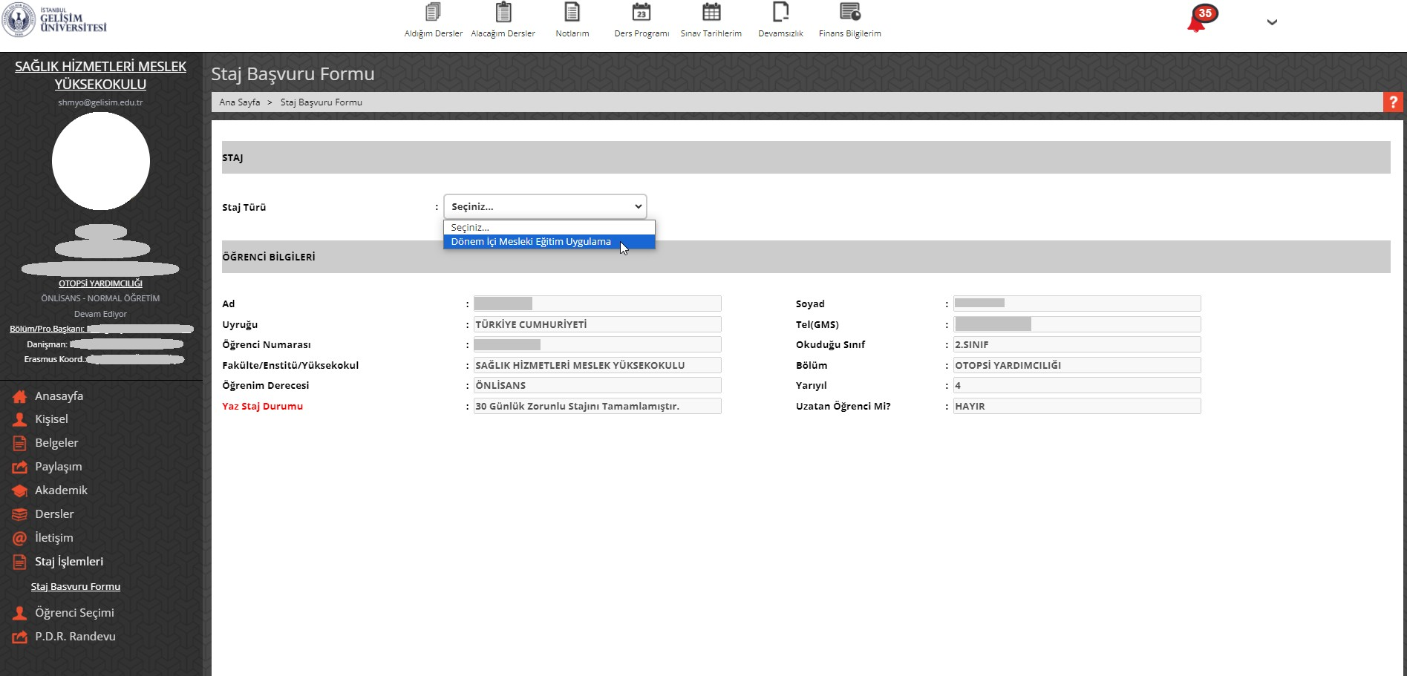
Click on "In-Term Professional Training Practice" as Internship Type.

Slide 4
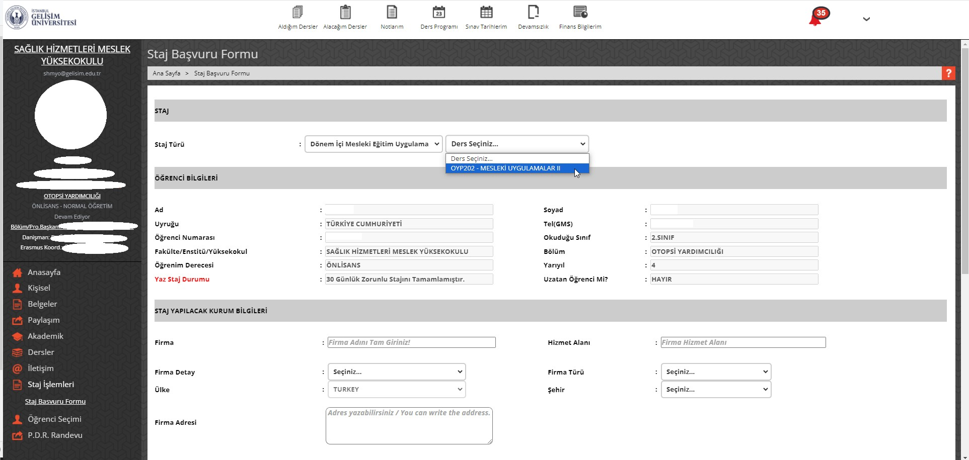
Select the Professional Practice Course You Chose During Course Registration

Slide 5
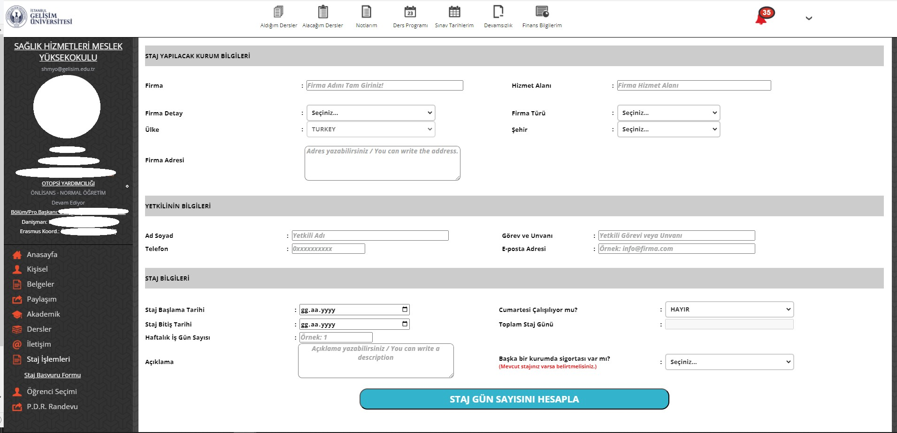
Fill in the relevant fields correctly and completely. After filling in the fields, click on the "Calculate the Number of Internship Days" button

Slide 6
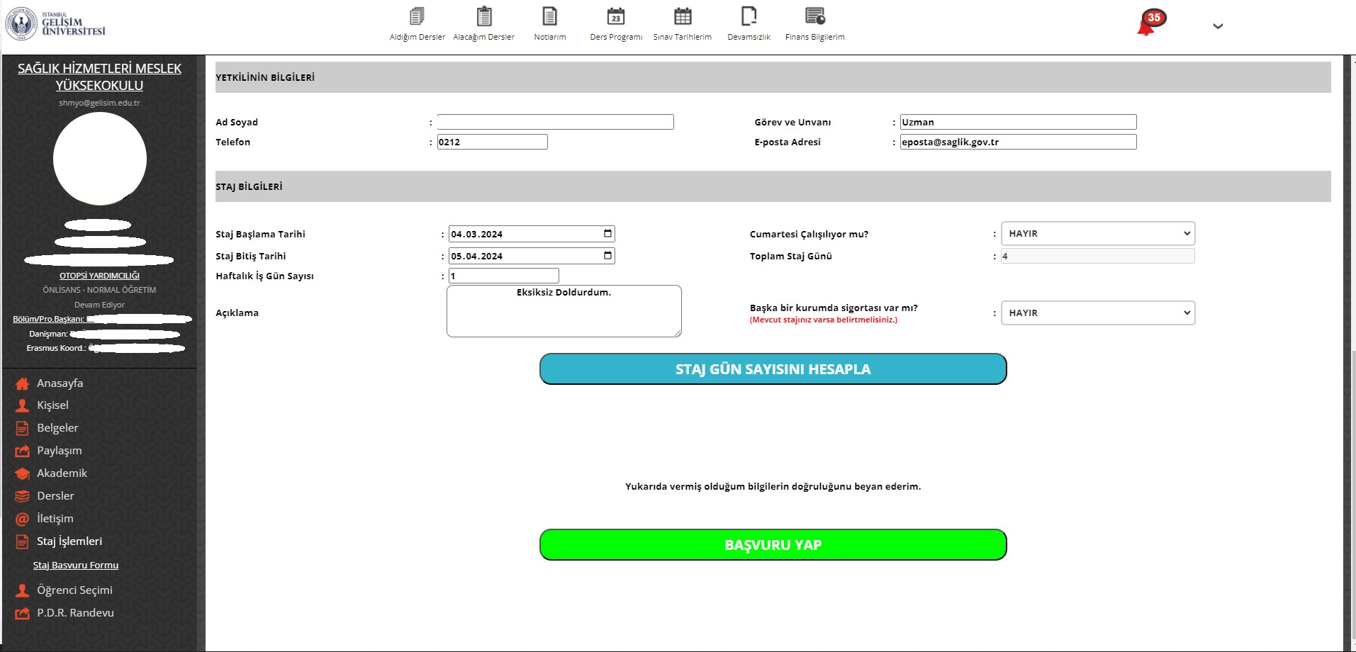
Click on the "Apply" button. If the Apply button does not appear, make sure that you have entered the above information completely and click the Calculate Internship Days button again.

Slide 7
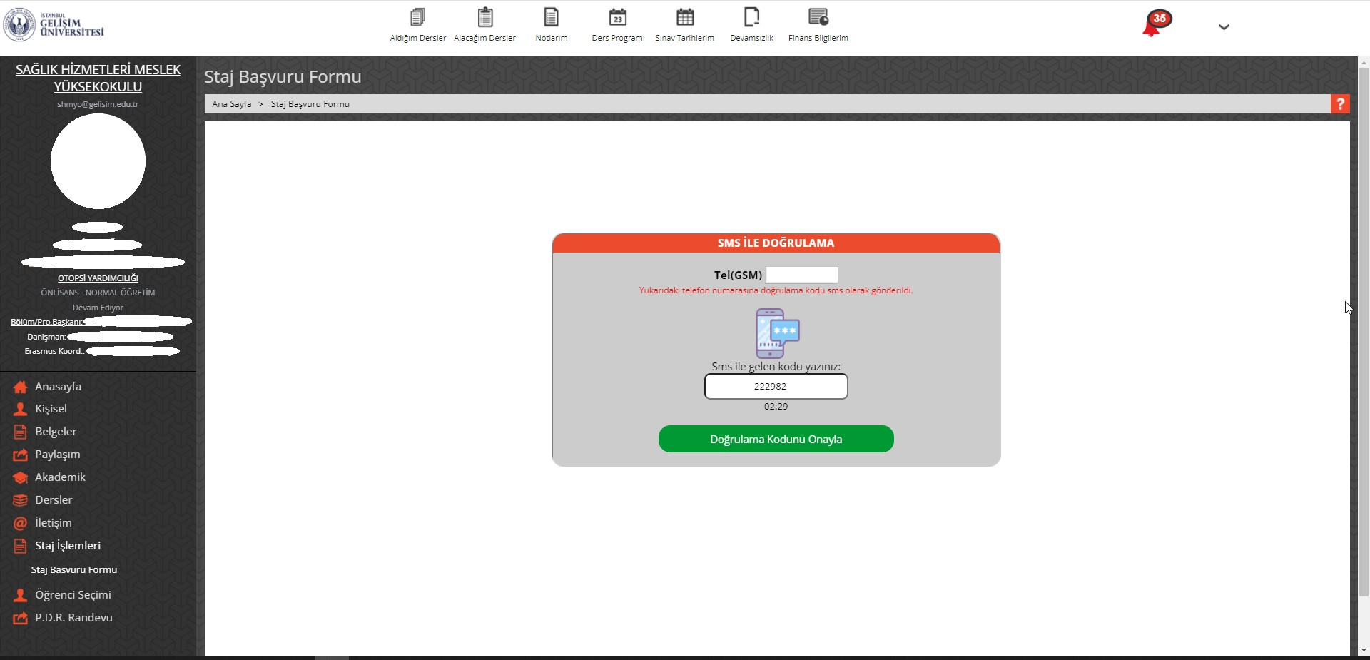
A verification code will be sent to your phone number registered in the system. After entering the verification code in the relevant field, click "Confirm Verification Code".

Slide 8
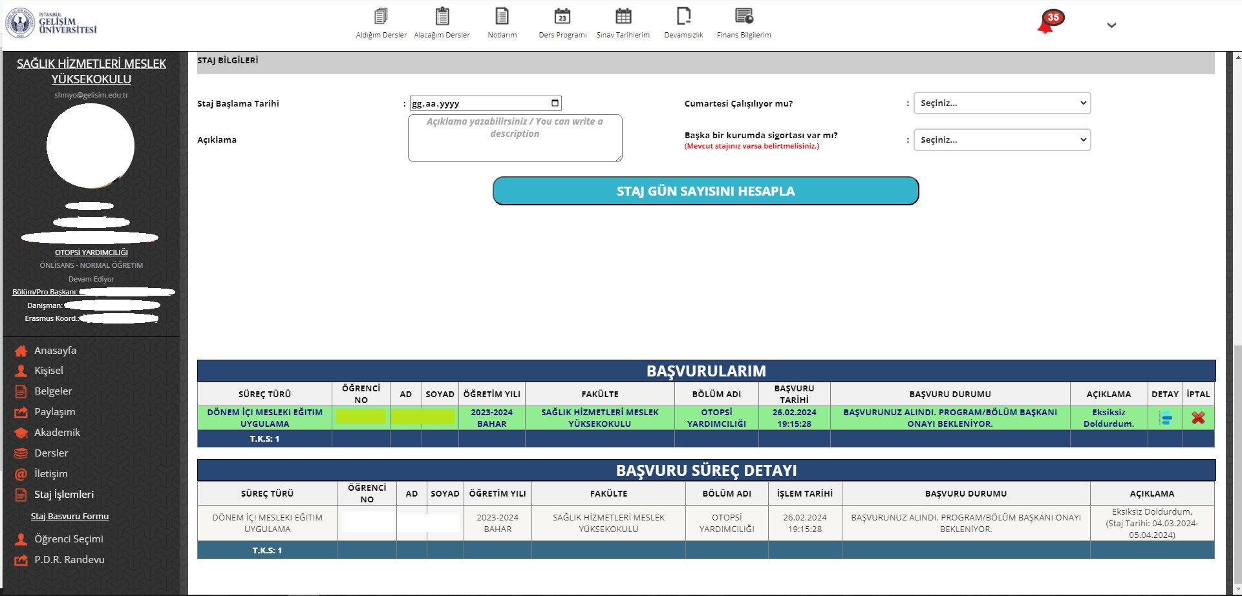
You can find out the application details by clicking on the "Detail" button.
The latest status of your application is displayed in the "Application Status" field.
After each process is completed, It will be added to the "Application Process Detail" table.

Slide 9
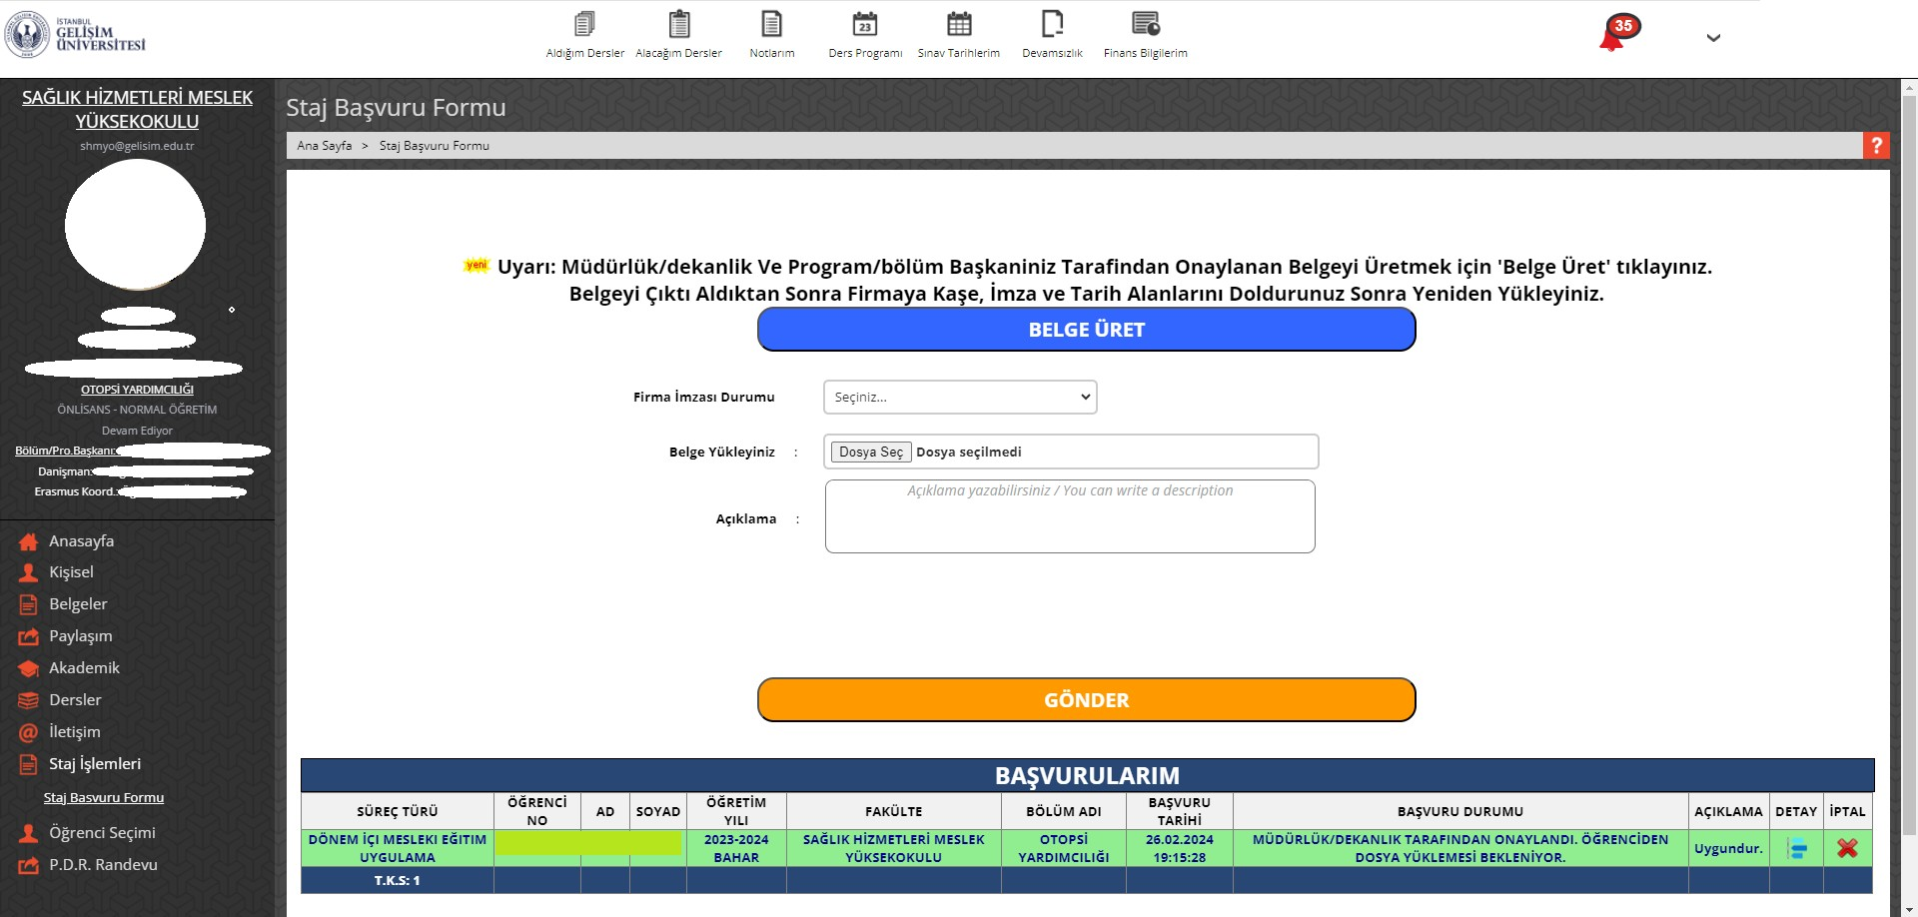
Click on the "Generate Document" button and get the document signed by the company.

Slide 10
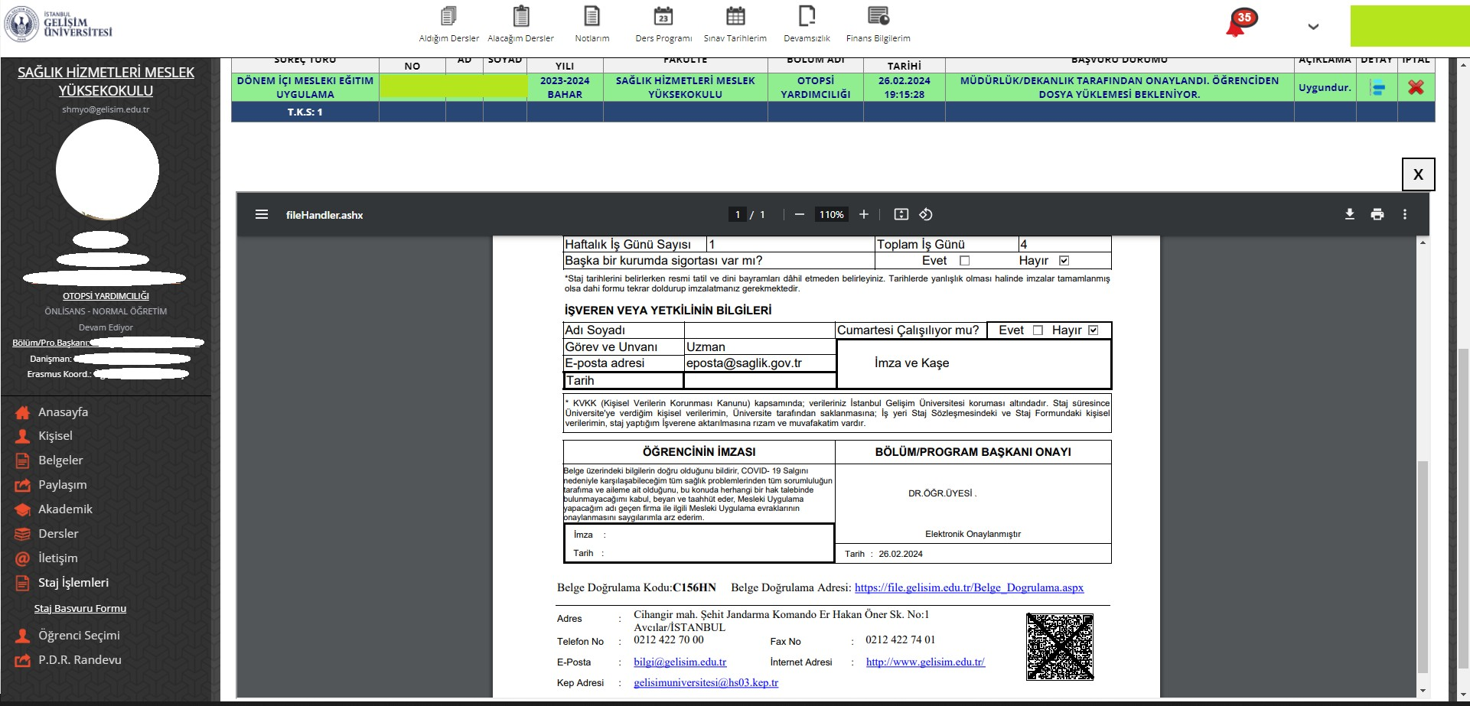
You can print the relevant form in the window that opens.
Write the date you had the company sign the form.
The relevant field must be signed and stamped by the company.
Please write down the current date and your own signature.

Slide 11
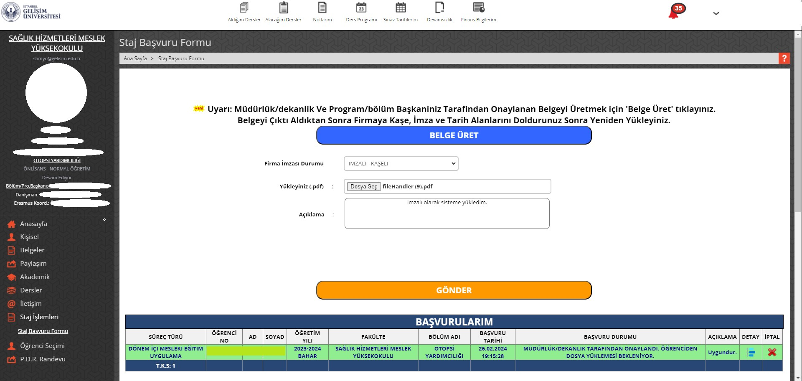
Select Signed - Stamped.
Please upload the signed and stamped form after converting it to *.pdf format.
After entering a description, click on the "Submit" button.

Slide 12
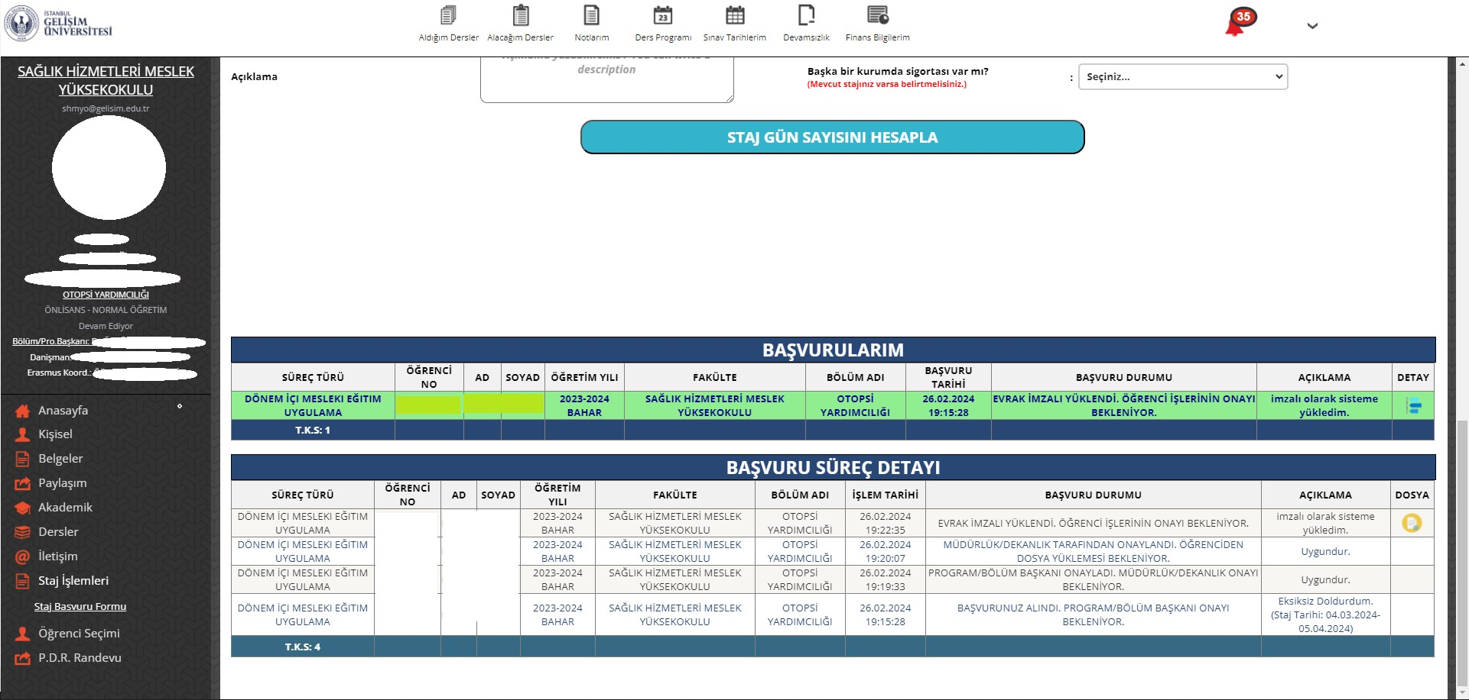
The latest status of your application is displayed in the "Application Status" field.
After each process is completed, It will be added to the "Application Process Detail" table.

Slide 13
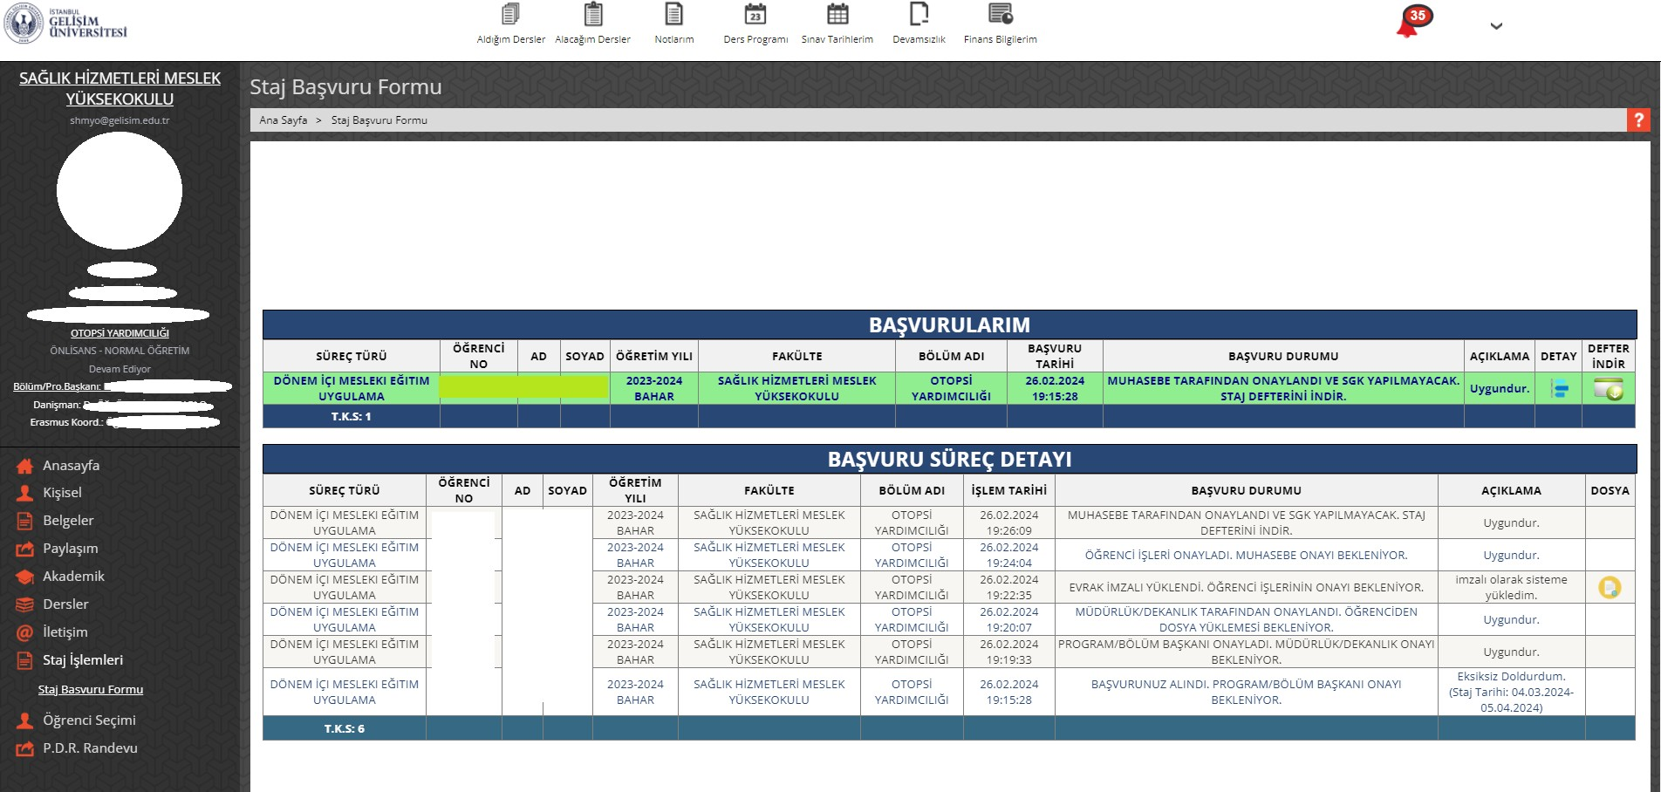
After the processes are completed, click on the "Download Internship Book" button.

Slide 14
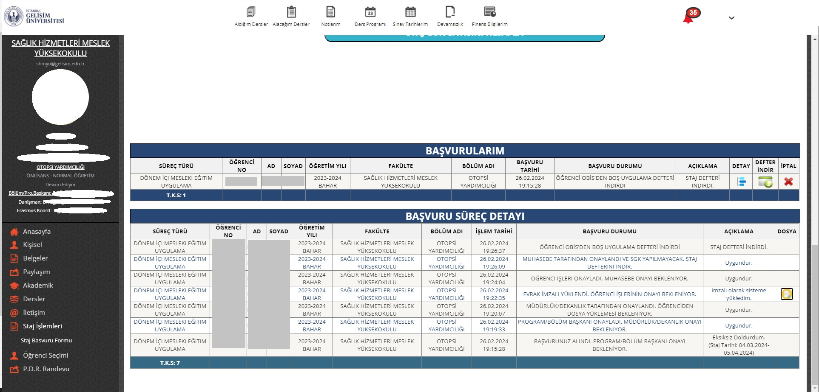
Your application process is over, you can download the internship book again at any time.

Slide 15
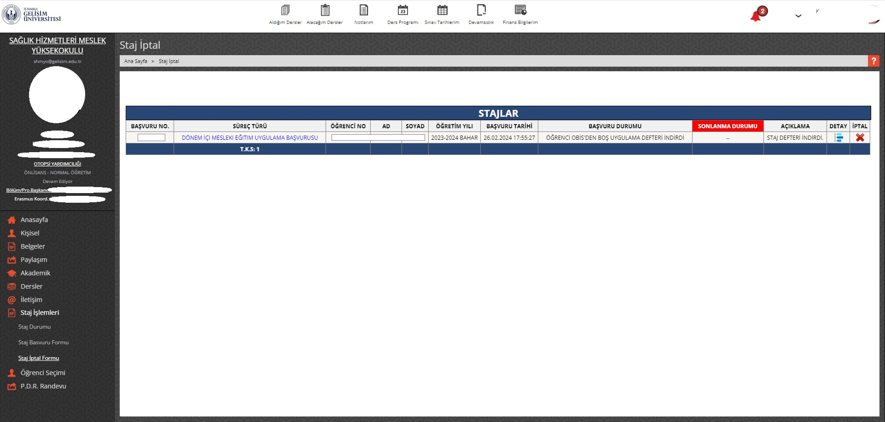
STAJ İPTAL SÜRECİ
Click "X" to Start the Cancellation Process.2
Click on the Internship Cancellation Form.1

Slide 16
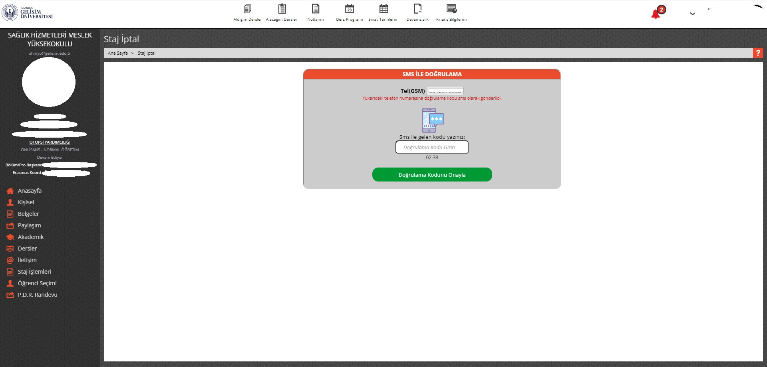
A verification code will be sent to your phone number registered in the system. After entering the verification code in the relevant field, click "Confirm Verification Code".
3

Slide 17
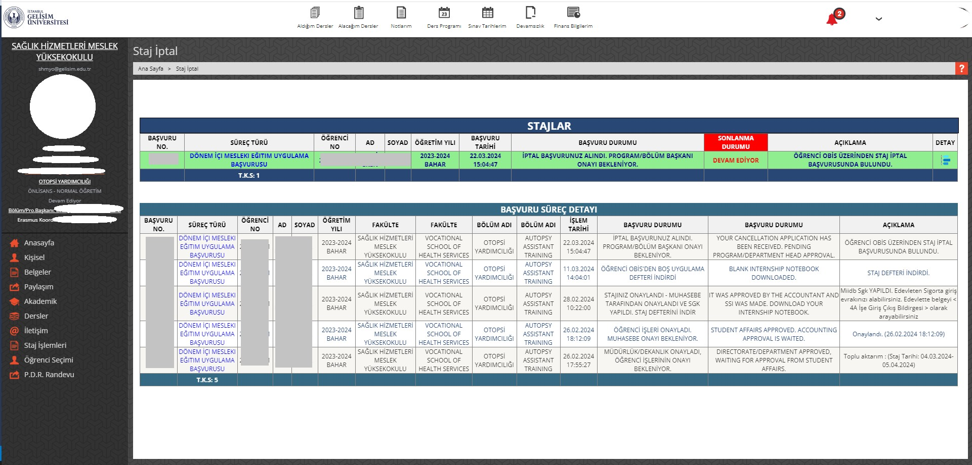
The latest status of your application is displayed in the "Application Status" field.5
After each process is completed, It will be added to the "Application Process Detail" table.
4

Slide 18
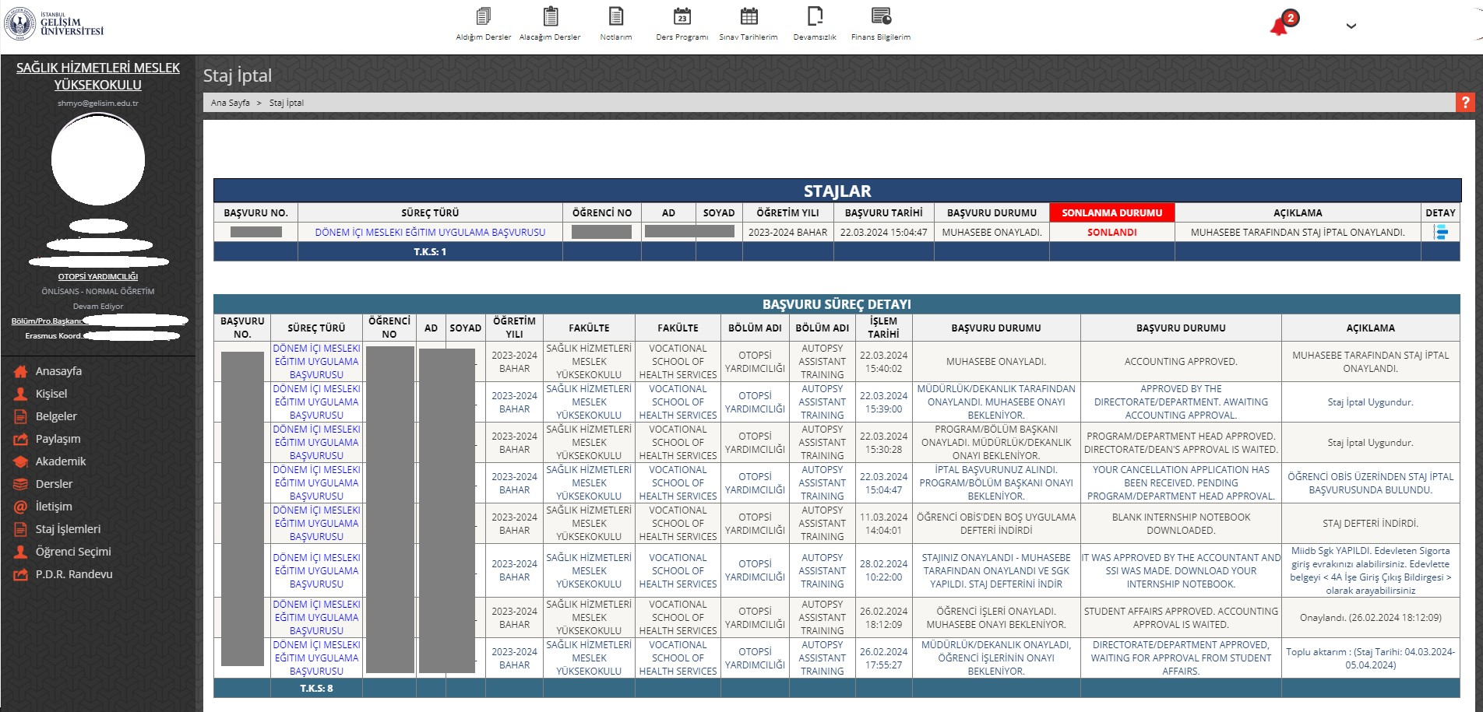
Your Internship Cancellation Application has been approved.5
After each process is completed, It will be added to the "Application Process Detail" table
6

