Slide 1
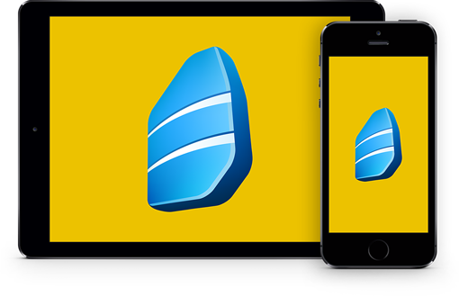
Rosetta Stone
Mobile Application Access
Steps

Slide 2
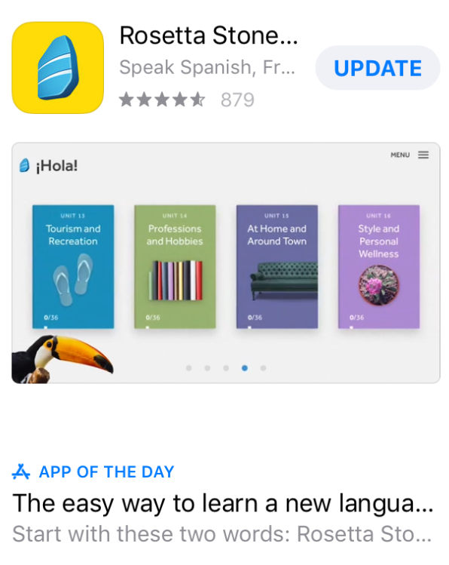
Downloading the app
Search for the "Rosetta Stone" application from the App Store for your Apple device and from the Google Play Store for your Android device.
Download the 'Learn Languages: Rosetta Stone' application.
DO NOT OPEN THE APP YET

Slide 3
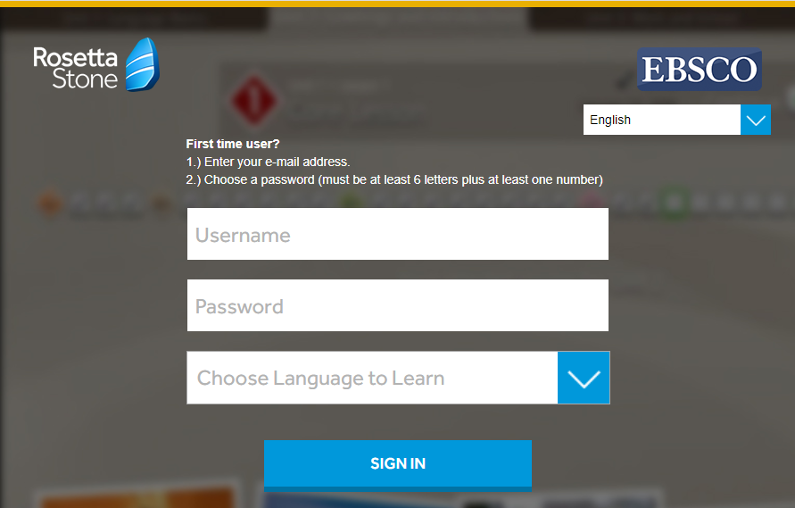
Access and Creating Username / Password
Log in from your computer by clicking the access link below. https://m.ebsco.is/RosettaStoneTurkiye
From the screen you see, create your institutional e-mail address and password that you will use for future logins to Rosetta Stone and select the language you want to learn. You can change the interface language in the upper right corner of the screen.

Slide 4
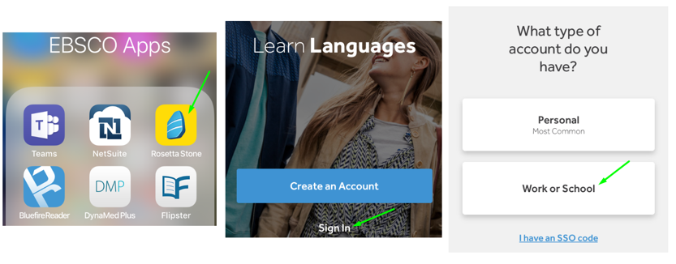
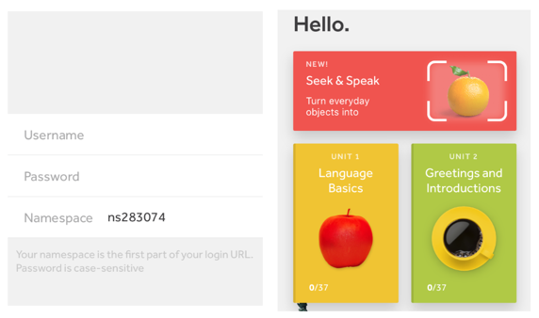
Introduction to Application
You can start learning anytime and anywhere. You can log in directly from the mobile application.
You just need to repeat steps 2 - 5 for which you want to change the language.
After clicking the "Sign In" and "Work or School" buttons, enter your username and password that you created in step 3. If your device does not automatically save, you will also need a namespace information. In trial versions, type (ns240700) in the namespace field and click on the 'Sign In' button.

Slide 5
THANK YOU!

