Slide 1
Rosetta Stone
Access from Desktop and User Guide

Slide 2
Rosetta Stone is on free trial access for 2 months!
It is the world's # 1 language training tool.
It uses “Dynamic Immersion” method.
Anytime and anywhere access via computer or mobile device.
It includes 30 languages.
Provides B1 (independent user) level for the language you have completed.

Slide 3
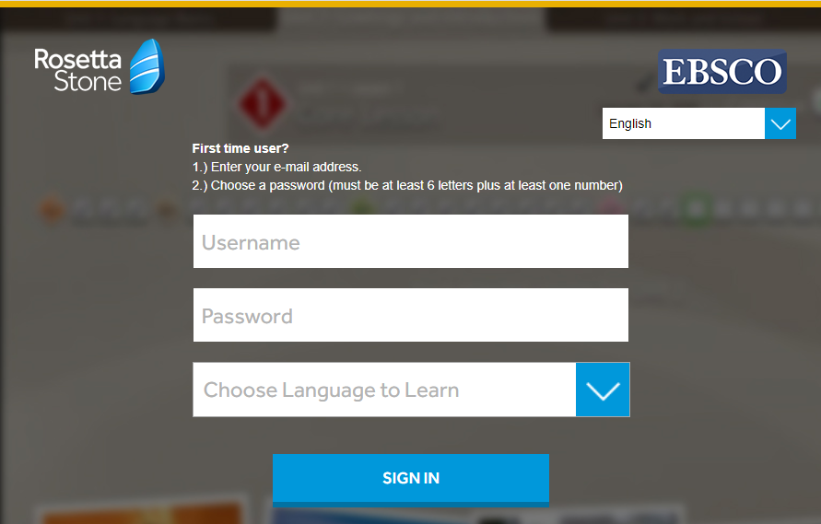
Access and Creating Username / Password
Login by clicking the access link. https://m.ebsco.is/RosettaStoneTurkiye
From the screen you see, create your institutional e-mail address and password that you will use for future logins to Rosetta Stone and select the language you want to learn. You can change the interface language in the upper right corner of the screen.

Slide 4
Connecting to the Rosetta Stone
Click on the "Launch Rosetta Stone Foundations" link and allow Rosetta Stone to open in the application.

Slide 5
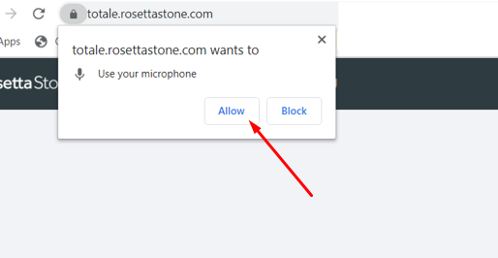
Connecting to the Rosetta Stone
Allow Rosetta Stone to use your microphone by clicking the "Allow" button. A microphone is required for exercises involving speaking and pronunciation. These exercises cannot be done without a microphone connection.

Slide 6
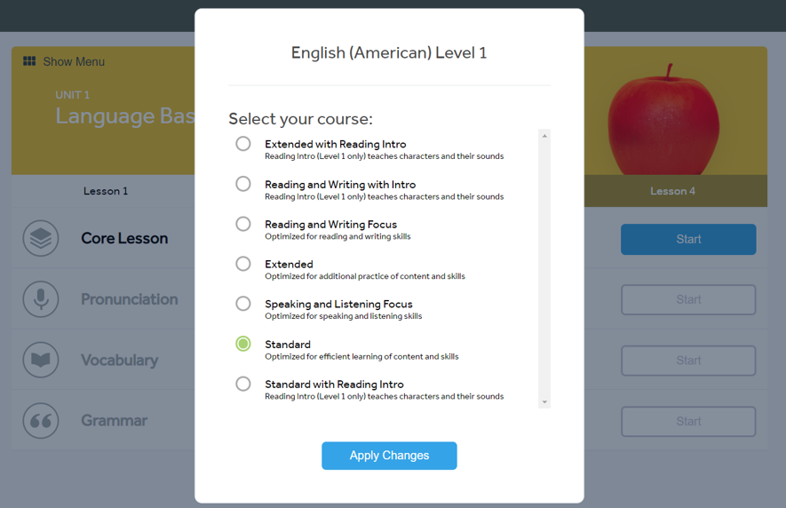
Curriculum Selection
Determine the curriculum you want to study for the language you have chosen. The distribution of the exercises will be made according to your choice. For example, in the "Standard" option, there will be an equal amount of practice from all skills (Reading, Writing, Speaking and Listening). Complete your selection by clicking the "Apply Changes" button.

Slide 7
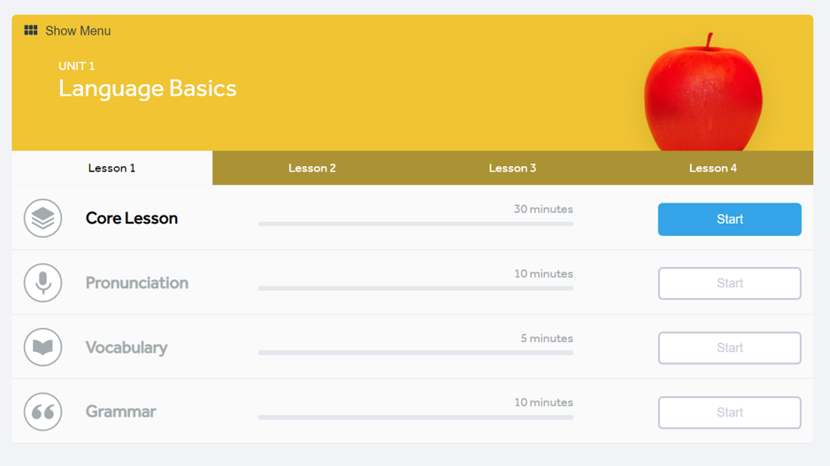
Units and Lessons
You will see the unit screen. With the "Start" button, you can start from the section called "Core Lesson" that includes activities. If you want, you can also complete focused activities such as pronunciation, vocabulary or grammar by using the "Start" button of the related exercise. The "Show Menu" at the top left will open the screen where you can list all units. Click on the "Show Menu" button.

Slide 8
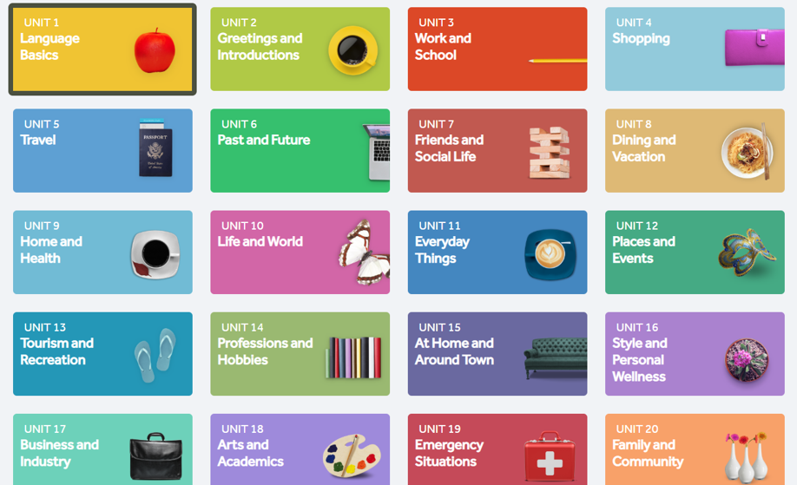
Unit Selection
You can start working by selecting any unit you want. Every 4 units means 1 level. Choose the unit you want according to your language level.

Slide 9
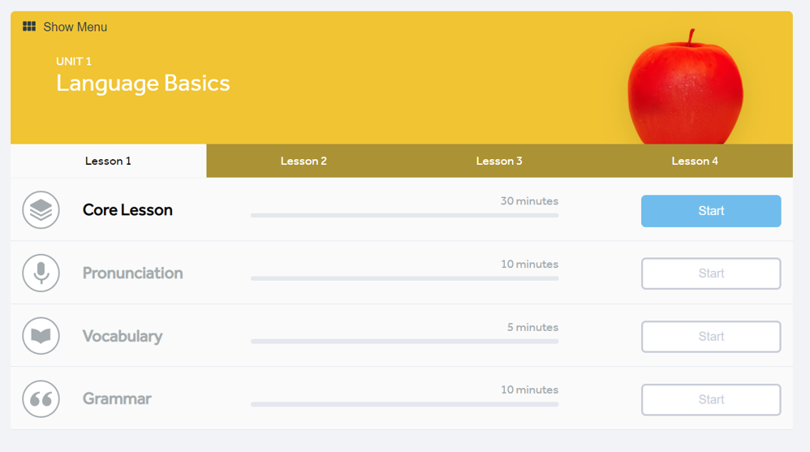
Course and Activity Selection
There are 4 lessons under each unit, 1 core lesson and different focused activities under each lesson. Although the recommended method is to proceed in order, you can choose the order you want. Use the "Start" buttons.

Slide 10
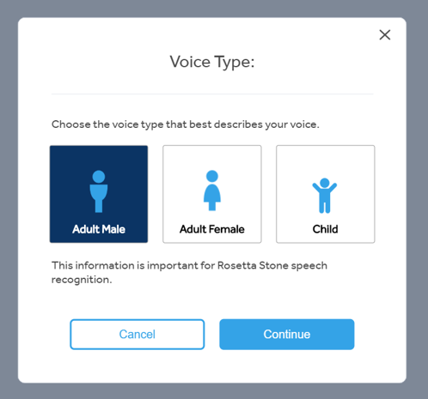
Voice Recognition
The microphone setup steps will follow before your first practice. First of all, for voice recognition, choose the one that suits you among Adult Male, Adult Female or Child and click the "Continue" button.

Slide 11
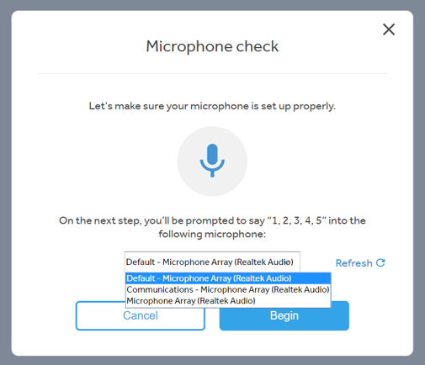
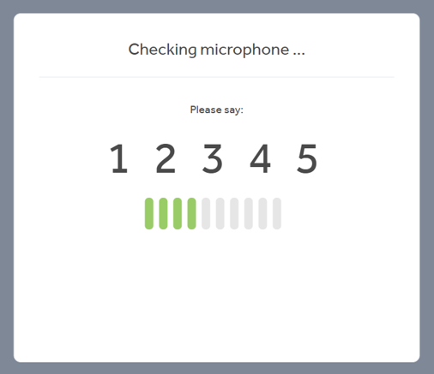
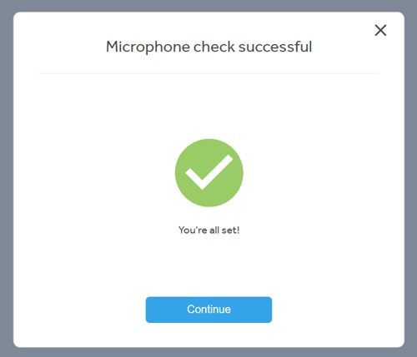
Microphone Setup
Select the microphone you are currently using and click the "Begin" button.
Speak for 5 seconds. For example, you can count up to 5.
Click the "Continue" button after the microphone installation process is completed.

Slide 12
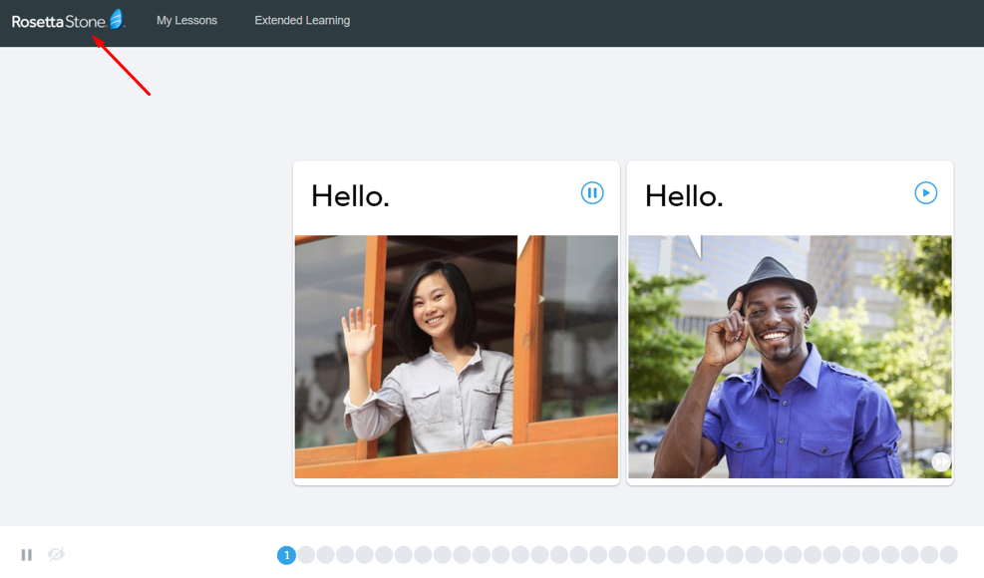
Practice Screen
You can now start practicing the exercises.
You can always return to the "My Lessons" tab where your courses are listed with the Rosetta Stone logo on the top left.

Slide 13
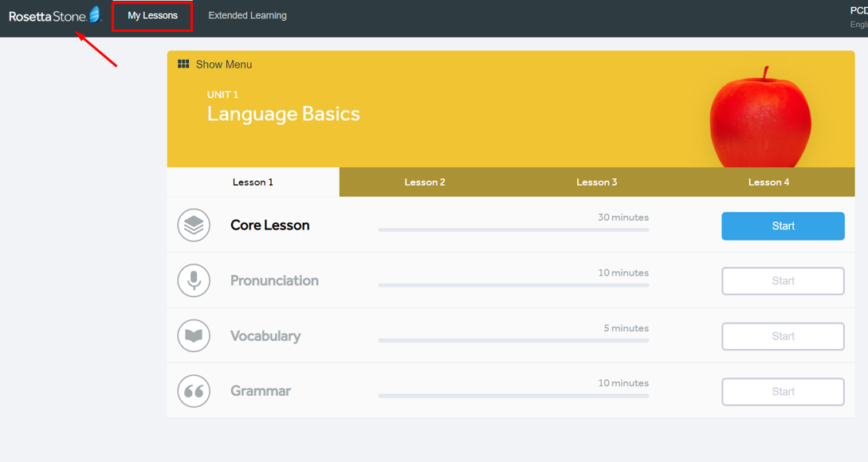
Return to the Course Screen
The Rosetta Stone logo at the top left will bring you to the "My Lessons" tab where your lessons are listed.

Slide 14
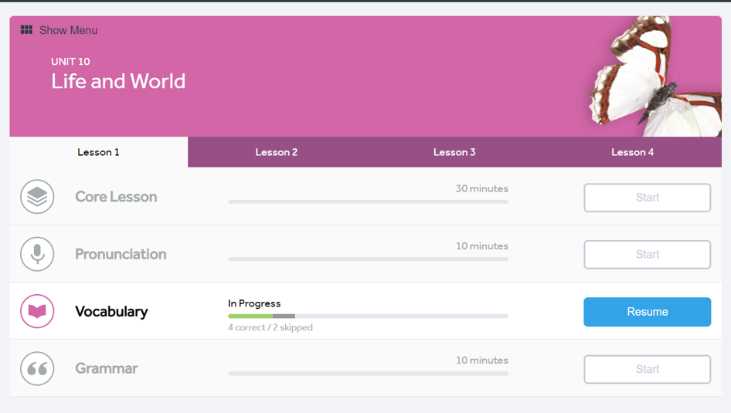
Previously Completed Exercises
Rosetta Stone saves the completed exercises, allowing you to track your learning progress and continue where you left off.

Slide 15
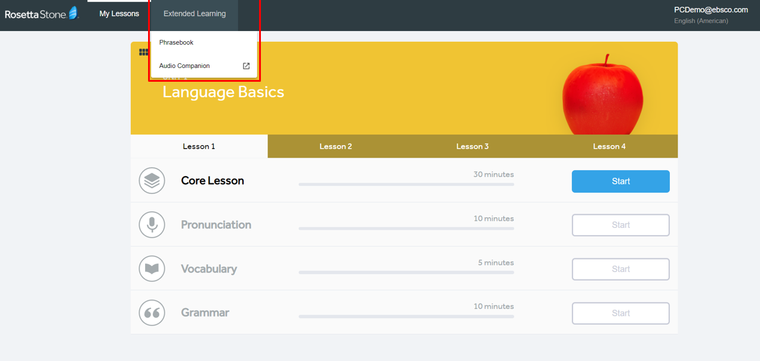
Extended Learning
Under the "Extended Learning" tab there are "Phrasebook" and "Audio Companion" exercises. With these exercises, you can both study the most frequently used phrases in daily life and practice listening.

Slide 16
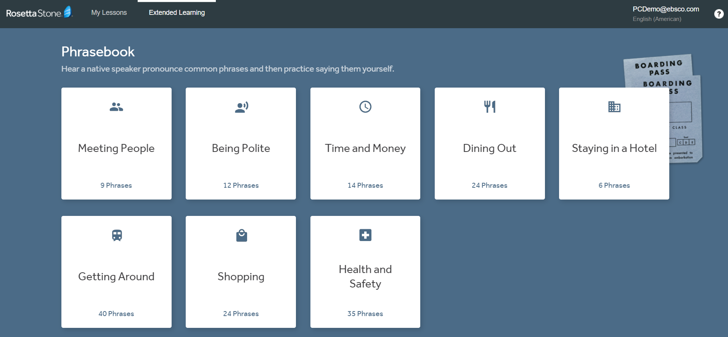
Extended Learning > Phrasebook
The "Phrasebook" section will prepare you for daily life. For example, in case you want to go out to dinner while abroad, you can review the most used phrases.

Slide 17
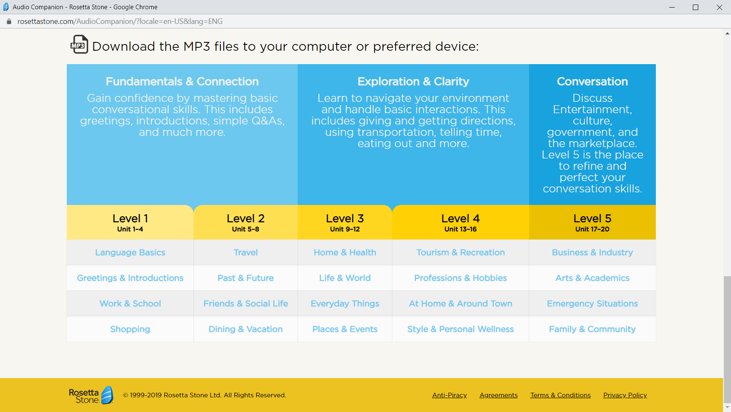
Extended Learning > Audio Companion
From the "Audio Companion" section, you can download and listen to the exercises you want as MP3.

Slide 18
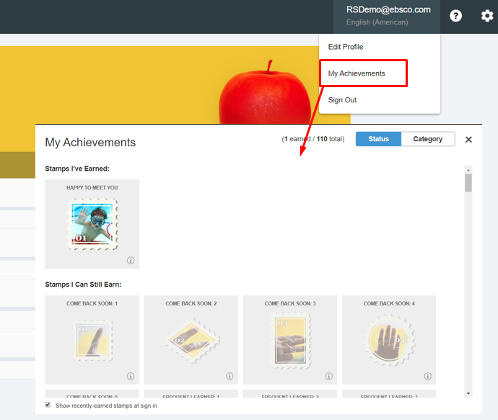
Tags – My Achievements
As you progress in Rosetta Stone, you can earn various tags. You can view all the tags you have earned and can earn in the "My Achievements" section.

Slide 19
THANK YOU!

